Slide 1
Victoria Housing Median Price Change from 2011-2021
Group 8
Selina Matthews, Shaun Xu, Haodong Zhang

Slide 2
Outline
01. Introduction
02. The Project
Our chosen topic and why it is important
The scope and elements of our project
03. Data Manipulation
04. Visualisations
05. Conclusions
The process of preparing the data
Outcome of the data and how we chose to display it
Our final thoughts on the data

Slide 3
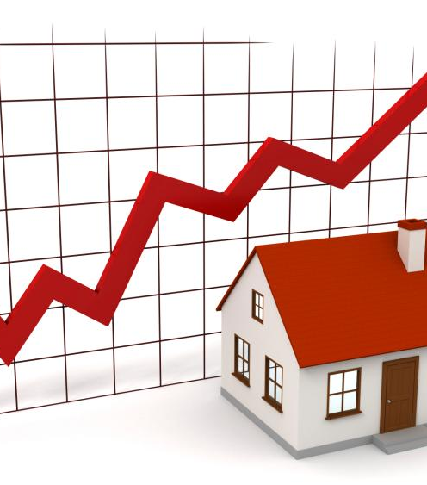
Introduction
Our aim was to investigate the relationship between the median house price and the economy of Australia, in order to see if there if there is any relationship, specifically between house prices and interest rates.
This was with 2 aspects in mind:
- How strong the relationship is
- Having an outcome where an individual is able to use our visualisations to see if their suburb of interest is a valuable investment or not

Slide 4
Our Project
Scope:
Elements incorporated:
The basis of our project was a dataset we found regarding the median house price for each Victorian suburb over the last 10 years (2011-2021 inclusive)
This included over 800 rows of property data.
This was then compared to the inflation rates, as well as data for the XJO, over the same period
Used pandas to filter and transform the data until it was ready to be uploaded into a database
Chose to upload everything to SQL due to our familiarity with it
Incorporated a new JavaScript library – sql.js, which converts sql databases into JavaScript typed arrays
Used Leaflet to create a choropleth map, with suburb popups that, once clicked, display a more complete version of the suburb’s information on the dashboard

Slide 5
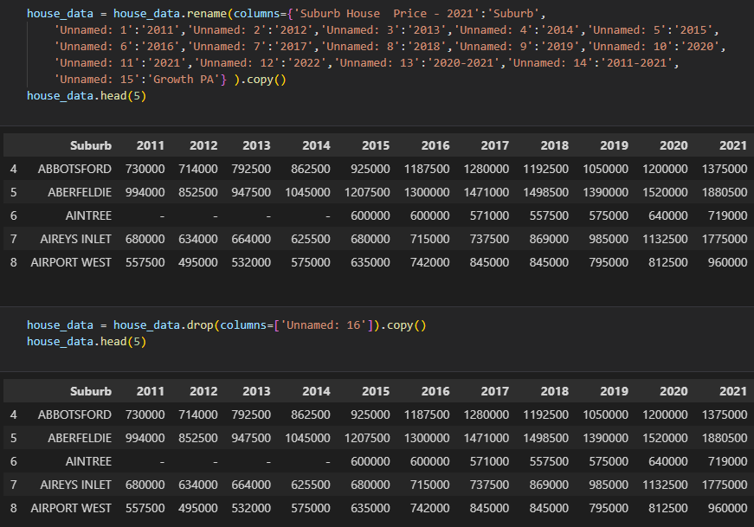
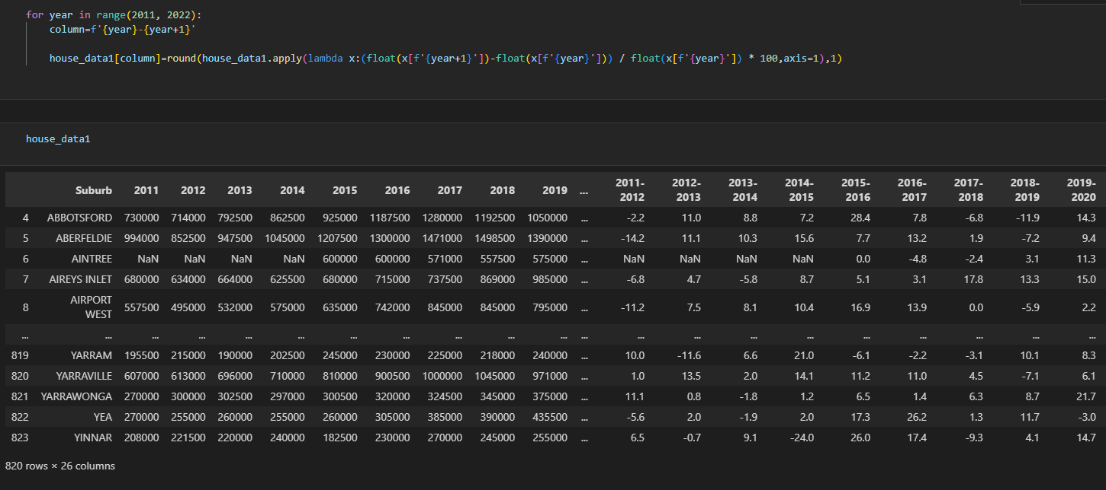
Data Manipulation
Clean Data of Suburb House Median Price
Data Analysis

Slide 6
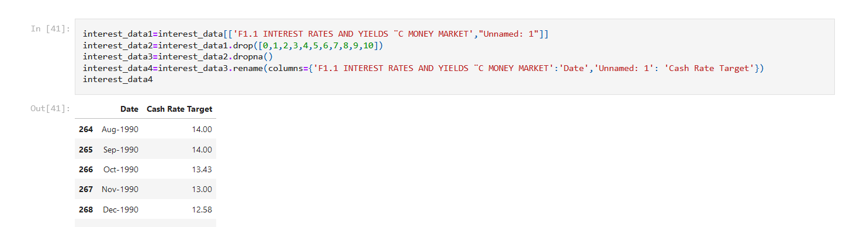
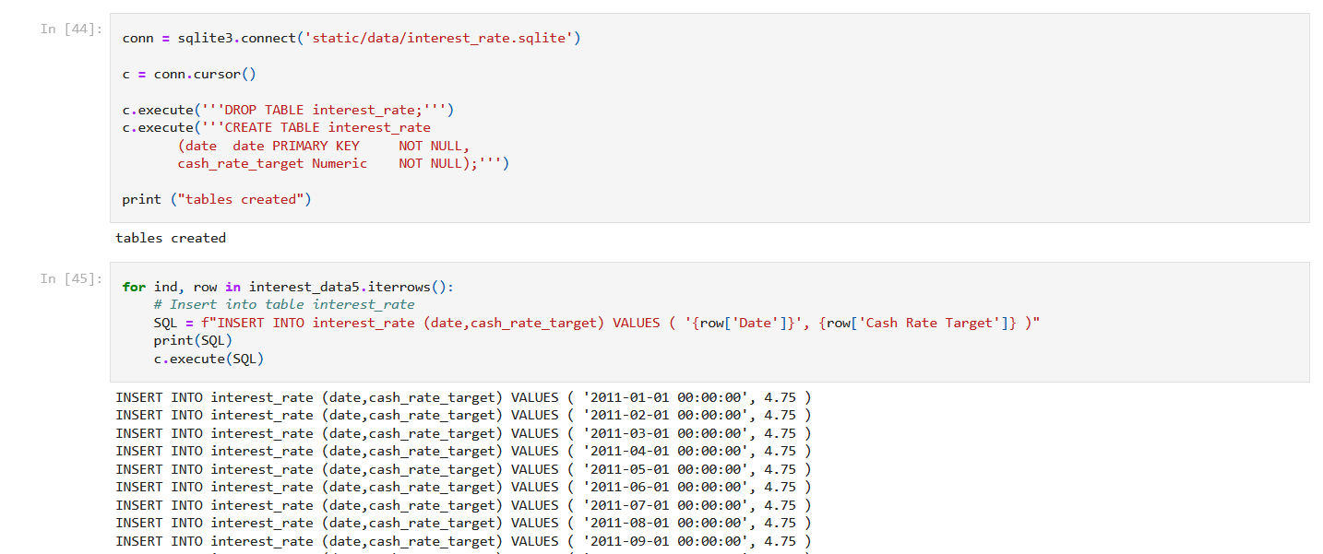
Data Manipulation
Dropping null values and renaming columns
Creating the tables in SQL and inserting the data

Slide 7
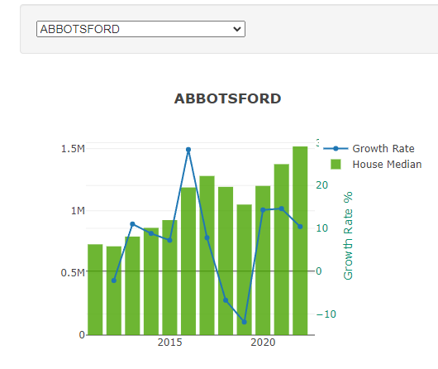
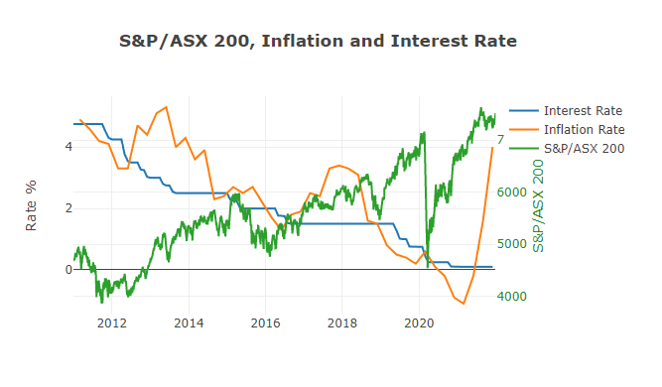
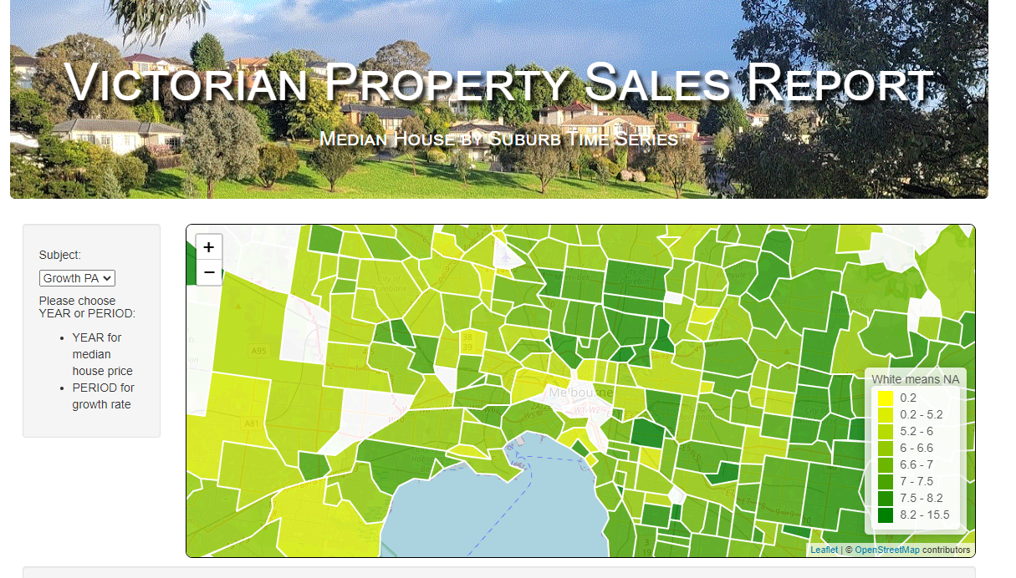
Visualisations
Choropleth map
Bar chart
Line graph

Slide 8
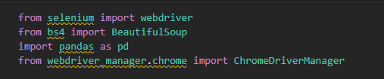
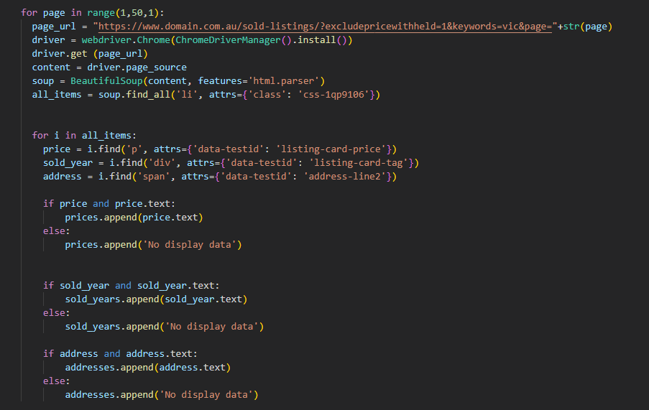
Web-Scraping
Selenium & BeautifulSoup
Scrap Domain.com

Slide 9
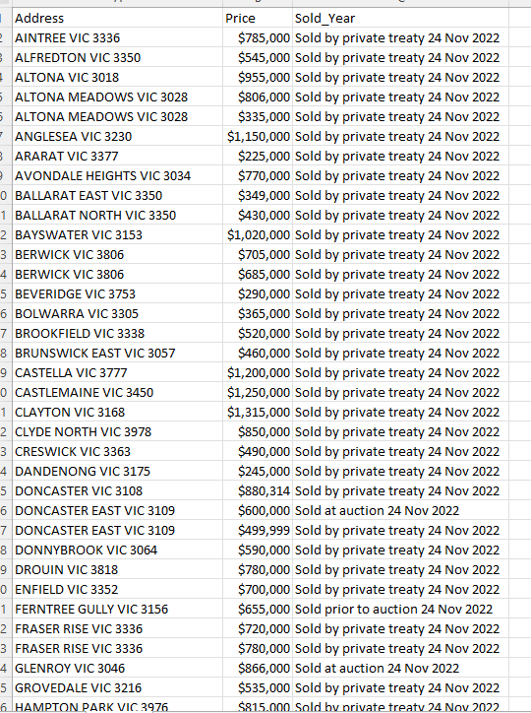
Web-Scraping
Results 1,000 Recent Records
Limitation:
Only first 50 Pages can be reviewed
Website blocks Selenium as Robot
Time & Energy Consuming for Large Data Scraping

Slide 10
Conclusions
Connection between house prices and interest rates
Insight into most valuable suburbs to invest in
As expected, while interest rates have been falling since the beginning of the timeframe our data looked at, house prices have been steadily rising, demonstrating a strong connection between these two aspects
Inflation rates seem to be more closely related to the S&P/ASX 200 data we used; however, this connection is tentative at best and not enough to draw any meaningful conclusions
Using the choropleth map, it is clear that many Melbourne suburbs are experiencing growth at the moment
Many of the areas with the highest growth rates appear to be in the northern and eastern suburbs, signaling them as great opportunities for investment based on past performance

Slide 11
Thank you!
Links to resources used:
https://www.rba.gov.au/statistics/
https://www.wsj.com/market-data/quotes/index/AU/XJO/historical-prices
https://discover.data.vic.gov.au/dataset/victorian-property-sales-report-median-house-by-suburb-time-series1/historical

